Slide 1
Crafting Digital Solutions
for Your Business
True Code Masters
Your business, Our priority
With…
A Commitment to Excellence
A Focus on Your Success and Growth

Slide 2
Why Companies Trust TCM?
True Code Masters
Your business, Our priority
Customized Solutions: Tailored to Their Specific Needs
Quality Assurance: Delivering Reliable & Secure Products
Proven Expertise: Backed by Years of Industry Experience
Dedicated Support: Ongoing Assistance For Their Tech Needs
Competitive Pricing: High-Quality Services At Affordable Rates
Trusted Partner: Over a Decade of Successful Projects Execution
Fully Scalable & Flexible Engagements : Adopting Their Changing Needs

Slide 3
Services We Offer
01
Core Development Services
02
Specialized Development Services
True Code Masters
Your business, Our priority
Web Application Development
Mobile Application Development
Custom Software Design and Development
Custom Business Application
CRM Application development
eCommerce Application Development
CMS Application Development

Slide 4
Services We Offer
03
Strategic Services
04
Maintenance and Support Services
True Code Masters
Your business, Our priority
On-Demand Dedicated Team
Startup and MVP Services
Legacy Application Modernization
Cloud Migration Services
Application Maintenance
UX/UI Design Support

Slide 5
Our Flexible Engagement Models
True Code Masters
Your business, Our priority
 | Time & Material Model (hourly model) | Fixed Price Model | Dedicated Team Model
Best Suited For | Startup Companies | Entrepreneurs, Startups, and Small to Large Enterprises | Entrepreneurs and Large Enterprises
When to Choose | The Scope Of Work Associated With A Project Isn’t Fully Defined And Will Be Continuously Evolving. | You Have Well-Defined Project Requirements For The Solution Or Application That You Wish To Develop | You Have Long-Term Projects & Need a Team That Can Scale Up or Down as Per Your Needs With a Greater Control and Flexibility
Budget | Fixed Hourly Rates, Providing Cost Control | Fixed Budget For The Entire Project | Fixed Budget Arrangements

Slide 6
Specialized Approach for…
True Code Masters
Your business, Our priority
Startups
Accelerate your product launch and gauge market response. Our MVP development services help you create a functional prototype quickly and cost-effectively
SMEs
Develop a customized solution that aligns with your business goals, without breaking a bank.
Enterprises
Gain access to top-tier talent and streamline your development process with our dedicated software developers.

Slide 7
Tech Stack
True Code Masters
Your business, Our priority
Frontend | ReactJS, Angular, VueJS & Blazer Application
Backend | .NET, .NET Core, C#, VB.NET, Web Api, Php, Python & NodeJS
Mobile Application | Android, Flutter, React Native, MAUI & Xamarin
Web development | .NET, .NET Core, ASP.NET MVC, ASP.NET Core, PHP, Laravel & NodeJs
Full Stack Development | MEAN Stack, MERN Stack
Cloud | AWS, Azure & GCS
Database | MongoDB, MySQL, MSSQL, Postgres & Oracle
Desktop Development | WPF - Windows Application

Slide 8
MISSION AND VISION
MISSION
VISION
True Code Masters
Your business, Our priority
To provide quality service to our clients and help their businesses grow. Our mission is just for our clients!! To make you happy is our prime objective.
To be one of the leading IT Company in the world that works beyond imagination.

Slide 9
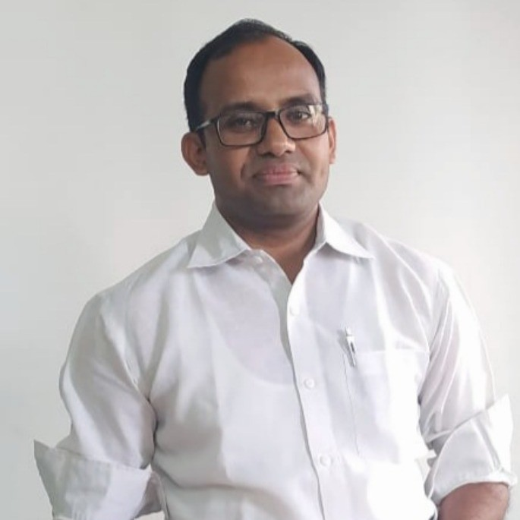
OUR MANAGEMENT
HEMANT YADAV
VIJAY SAHU
CEO & FOUNDER
Total 15 years’ experience in IT industry, in development, Team leading and Project management.
CTO
Total 18 years’ experience in IT industry, in development, Team leading and Project management.

Slide 10
RECENT CLIENT
True Code Masters
Your business, Our priority

Slide 11
Get in Touch
True Code Masters
Your business, Our priority
India - Ahmedabad
A/1001 Sunwest Bank,
Near Vallabh Sadan Riverfront,
Opp. City Gold Cinema,
Ashram Rd, Ahmedabad -380015.
+91 915 7825 334
info@truecodemasters.com
South Africa
White Thorn Office Park,
Unit B4, 606 Kudu Street,
Allen’s Nek,
X 27 Code 1737.
info@truecodemasters.com

